Slide 1
Sequence alignment on genome
Yin Tong

Slide 2
What is Genome assembly/mapping
Genome assembly/mapping refers to the process of taking a large number of short DNA sequences and putting them back together to create a representation of the original chromosomes from which the DNA originated
NGS, reads, align, overlap, assembly

Slide 4
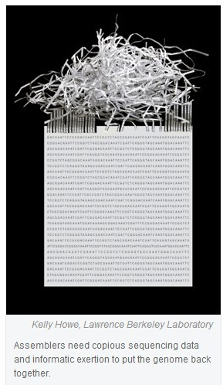

Slide 5
De-novo vs. mapping assembly
De-novo: assembling short reads to create full-length (sometimes novel) sequences
Mapping: assembling reads against an existing backbone sequence, building a sequence that is similar but not necessarily identical to the backbone sequence

Slide 6
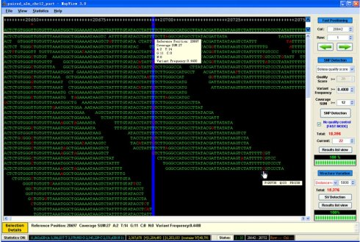
Short Read Alignment
Given a reference and a set of reads, report at least one “good” local alignment for each read if one exists

Slide 7
Short Read Applications

Slide 8
Characteristics and requirements of new alignment algorithms
Millions of reads per run(30x of genome coverage)
Short Reads(as short as 36bp)
Different types of reads(single-end,paired-end)
Base-calling quality factors
Sequencing errors(~1%)
Repetitive regions
Sequencing organism vs. reference genome
Must adjust to evolving sequencing technologies and data formats

Slide 9
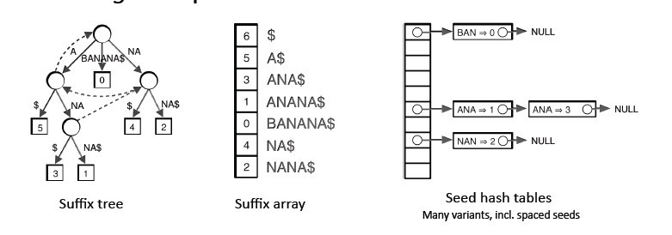
Indexing
Genomes and reads are too large for direct approaches like dynamic programming
Indexing is required
Choice of index is key to performance

Slide 10
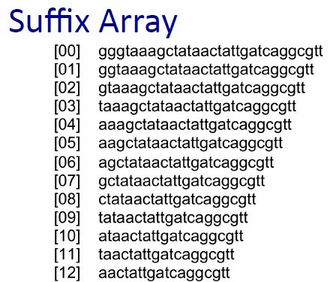
Index: an auxiliary data structure
Hash table
Key value → Hash function → Hash table
Suffix arrays

Slide 11
Burrows Wheeler Transformation(BWT)
Invented by David Wheeler in 1983
Originally developed for compressing large files
Approach:
1 Align reads on the transformed reference genome, using an efficient index(FM index)
2 Solve the simple problem first (align one character) and then build on that slightly harder problem (two characters)
Results in great speed and efficiency gains

Slide 12
Softwares

Slide 13
Bowtie2
Bowtie is an ultrafast, memory-efficient alignment program for aligning short DNA sequence reads to large genomes. For human genome, Burrows-Wheeler indexing allows Bowtie to align more than 25 million reads per CPU hour with a memory footprint of approximately 1.3 gigabytes. Bowtie extends previous Burrows-Wheeler techniques with a novel quality-aware backtracking algorithm that permits mismatches. Multiple processor cores can be used simultaneously to achieve even greater alignment speeds.

Slide 14
Task: Aligning short sequencing reads with Bowtie2
Aligning example set of short reads to a reference genome

Slide 15
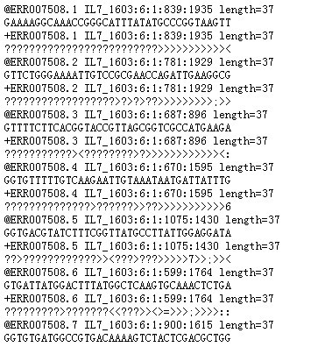
Recognize FASTQ and SAM

Slide 16
Softwares related
Bowtie2
samtools
IGV
IGV-Tools
SRA-Toolkit

Slide 17
Thank you

